Slide 1
Intro to C++

Slide 2
How program is executed

Slide 3
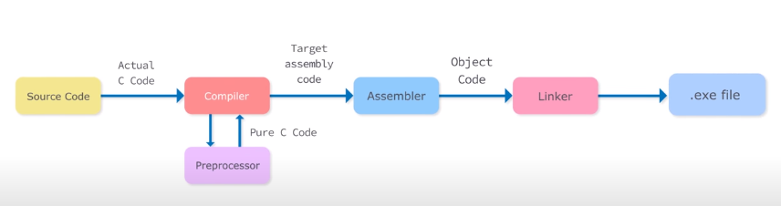

Slide 4
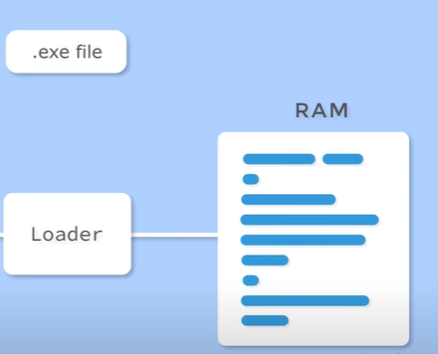

Slide 5
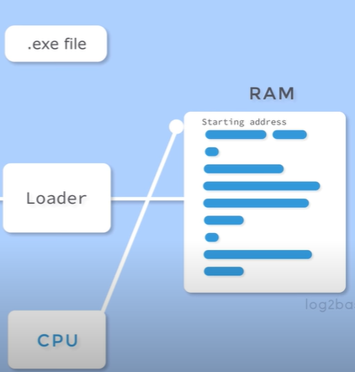

Slide 6
Writing first Program in C++
// This is a simple C++ program. Call this file Sample.cpp.
#include <iostream>
using namespace std;
int main()
{
cout << "C++ is power programming.";
return 0;
}

Slide 7
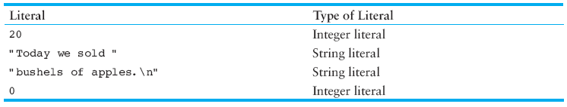
Variable and Literal
Variables represent storage locations in the computer’s memory.
Literals are fixed values that are assigned to variables.
Literals are also called constants

Slide 8
Variable
Variables stores data at particular memory location:
Name
Type
Value
Size
Lifetime + Variable scope + Variable visibility
Polarity
Address

Slide 9
1. Variable Name
Also referred to as identifiers
Rules:
You cannot use a C++ keyword (reserved word) as a variable name.
Variable names in C++ can range from 1 to 255 characters.
All variable names must begin with a letter of the alphabet (a-z, A-Z) or an underscore( _ ).
After the first initial letter, variable names can also contain letters and numbers.
No spaces or special characters are allowed.
C++ is case Sensitive. Uppercase characters are distinct from lowercase characters.

Slide 10
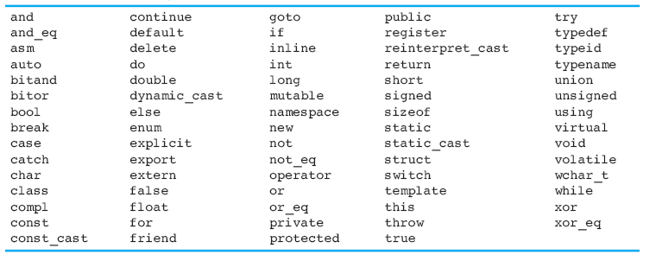
C++ Reserved Keywords

Slide 11
2. Data Types
There are many different types of data. Variables are classified according to their data type, which determines the kind of information that may be stored in them.
C++ recognizes following built-in data types which are designated by reserved words:
char
short
float
long double
unsigned int
unsigned long int
long
double
unsigned char
unsigned short
boolean

Slide 12
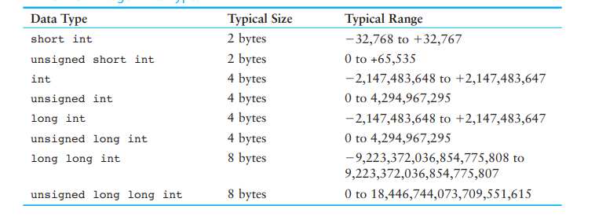
Integer Data types
Integer variables can only hold whole numbers.
Notes:
NOTE: An unsigned int variable can also be de ned using only the word unsigned.
For example, the following variable definitions are equivalent.
unsigned int days;
unsigned days;

Slide 13
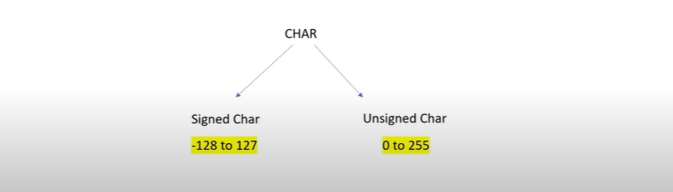
1 Byte

Slide 14
The bool Data Type
Boolean variables are set to either “true” or “false”.

Slide 15
3. Size of Variable
Memory occupied by a variable.
Express in bytes [1 byte = 8 bits]
Depends upon the type of variable
The sizeof operator is used to determine the size of a variable.
sizeof (data type)
4. Polarity
Signed or Unsigned
Only integer or character can be signed

Slide 16
5. Variable Lifetime: The lifetime of a variable the time period in which the variable is in memory.
6. Variable scope: A variable s scope is the part of the program that has access to the variable.
7. Variable visibility: Availability of a variable.
8. Address of variable: Where a variable reside in memory. Can be displayed using “&” operator.
Notes:
Scope & Lifetime
The scope of a declaration is the part of the program for which the declaration is in effect.
C/C++ use lexical scoping.
The lifetime of a variable or object is the time period in which the variable/object has valid memory.
Lifetime is also called "allocation method" or "storage duration."
Lifetime
Static: A static variable is stored in the data segment of the "object file" of a program. Its lifetime is the entire duration of the program's execution.
Automatic: An automatic variable has a lifetime that begins when program execution enters the function or statement block or compound and ends when execution leaves the block. Automatic variables are stored in a "function call stack".
Dynamic: The lifetime of a dynamic object begins when memory is allocated for the object (e.g., by a call to malloc() or using new) and ends when memory is deallocated (e.g., by a call to free() or using delete). Dynamic objects are stored in "the heap".
Scope
Local scope: "visible" within function or statement block from point of declaration until the end of the block.
Class scope: "seen" by class members.
Namespace scope: visible within namespace block.
File scope: visible within current text file.
Global scope: visible everywhere unless "hidden".

Slide 17
Named Constants
Literals may be given names that symbolically represent them in a program.
const qualifier is used.
const int a =10;
Remember when a value is declared const it is assigned a value immediately and that value is Read only. i.e. we can not change it.

Slide 18
Starting C++
C++ statements
Statements are fragments of the C++ program that are executed in sequence
Two types of statements
Simple statements: Single line of code
Compound Statements: Compound statements are multiple lines or curly braces-enclosed sequences of statements called blocks.

Slide 19
Simple statements
Declaration Statement
Assignment statement
Expression statement
Labels

Slide 20
Compound statements
Selection statements
If statement
If-else
Nested if else
Switch
Iteration Statements
While loop
Do while loop
For loop
Jump statements
Break
Continue
Return
Goto identifier

Slide 21
Variable deceleration and Initialization/Assignment
int a; //Declaration
a = 15; // Initialization
a = 30; //Assignment
int a=15; // Declaration + Initialization
int a, b, c, d; // Multiple Declaration
a=b=c=d=10; // Multiple Assignment
int a=b=c=d=10; //
Int a,b,c,d=10; //

Slide 22
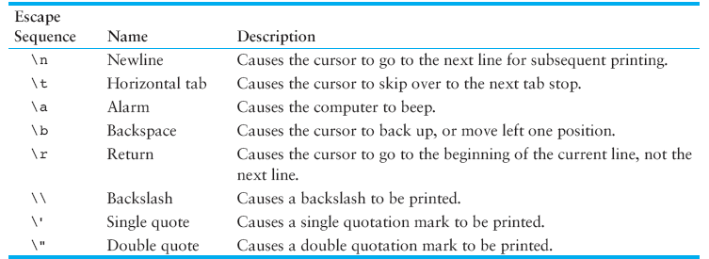
Escape sequences / Control Characters

Slide 23
Another Simple Program: Adding Two Integers
1 // code4.cpp
2 // Addition program.
3 #include <iostream>
4
5 // function main begins program execution
6 int main()
7 {
8 int integer1; // first number to be input by user
9 int integer2; // second number to be input by user
10 int sum; // variable in which sum will be stored
11
12 std::cout << "Enter first integer\n"; // prompt
13 std::cin >> integer1; // read an integer
14
15 std::cout << "Enter second integer\n"; // prompt
16 std::cin >> integer2; // read an integer
17
18 sum = integer1 + integer2; // assign result to sum
19
20 std::cout << "Sum is " << sum << std::endl; // print sum
21
22 return 0; // indicate that program ended successfully
23
24 } // end function main

Slide 24
Enter first integer
45
Enter second integer
72
Sum is 117

Slide 25
Expressions
C++ expressions are used to express computation.
Expressions include operations and the operands on which the operations are applied.
Operands can be variables, literals or constants.

Slide 26
Operators in C++
Arithmetic operators
Relational operators
Logical operators
Bitwise operators
Ternary, sizeof, typecasting, new and many more
Three things are important about operators
Precedence
Associativity
Arity

Slide 27
Precedence
Precedence controls the order of evaluation of operators.
A high precedence means an operator is evaluated (applied) before any lower precedence operators.
Operators that have the same precedence can happen in either order, but in C++ the one on the left is evaluated first.

Slide 28
Arithmetic
Rules of operator precedence
Operators in parentheses evaluated first
Nested/embedded parentheses
Operators in innermost pair first
Multiplication, division, modulus applied next
Operators applied from left to right
Addition, subtraction applied last
Operators applied from left to right

Slide 29
Confusing Equality (==) and Assignment (=) Operators
Example
if ( payCode == 4 )
cout << "You get a bonus!" << endl;
If paycode is 4, bonus given
If == was replaced with =
if ( payCode = 4 ) cout << "You get a bonus!" << endl;
Paycode set to 4 (no matter what it was before)
Statement is true (since 4 is non-zero)
Bonus given in every case

Slide 30
Confusing Equality (==) and Assignment (=) Operators
Lvalues
Expressions that can appear on left side of equation
Can be changed (I.e., variables)
x = 4;
Rvalues
Only appear on right side of equation
Constants, such as numbers (i.e. cannot write 4 = x;)
Lvalues can be used as rvalues, but not vice versa

Slide 31
Arity of operators
Unary Operator – one operand: a++, -a
Binary Operator – two operands: a – b, a+b
Ternary

Slide 32
Integer vs. floating point math
How does C++ know whether to use floating point or integer math operators?
If either operand is floating point, a floating point operation is done (the result is a floating point value).
If both operand are integer the result is an integer (even division).

Slide 33
Division
Floating point division
when at least one of the operands is FP
Integer division
when both operands are integer
7 / 2 →
3
7.0 / 2.0 →
3.5
7.0 / 2 →
3.5
7 / 2.0 →
3.5

Slide 34
Expression
Value
10 / 2 * 3
15
10 / 3 * 3
9
10 % 3 - 4 / 2
-1
2 + 3 * 4
14
(2 + 3) * 4
20
5 * 2 / 4 * 2
4
5.0 * 2.0 / 4.0 * 2.0
5.0
5.0 * 2.0 / (4.0 * 2.0)
1.25
10 - 10 / 3 * 3
1

Slide 35
Compound Expressions
avgTemp = FREEZE_PT + BOILING_PT;
avgTemp = avgTemp / 2.0;
✗
avgTemp = FREEZE_PT + BOILING_PT / 2.0;
avgTemp = (FREEZE_PT + BOILING_PT) / 2.0;

Slide 36
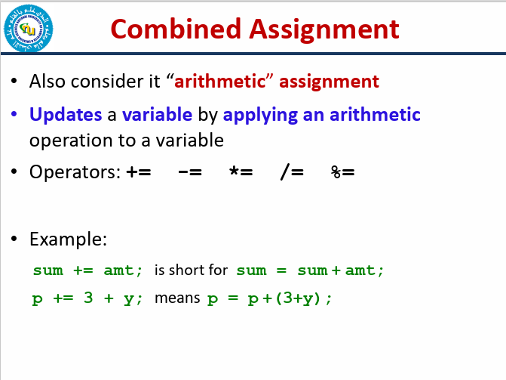

Slide 37
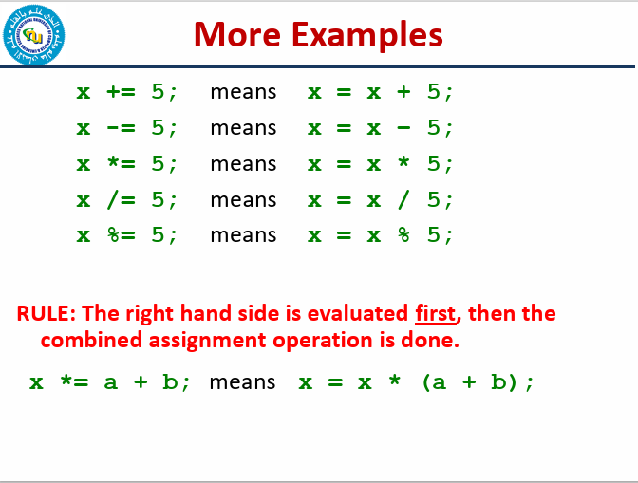

Slide 38
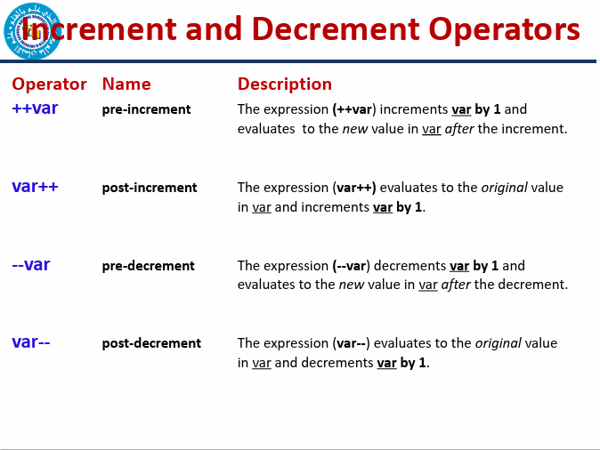

Slide 39
Evaluate the followings:
int val = 10;
int result = 10 * val++;
cout<<val<<“ “<<result;
int val = 10;
int result = 10 * ++val;
cout<<val<<“ “<<result;
Output
11 100
11 110

Slide 40
Output of the following code:
#include <iostream>
using namespace std;
int main()
{
int x = 5, y = 5, z;
x = ++x;
y =--y;
z = x++ + y--;
cout << z<<endl;
cout << x<<endl;
cout << y<<endl;
return 0;
}
Output
10
7
3

Slide 41
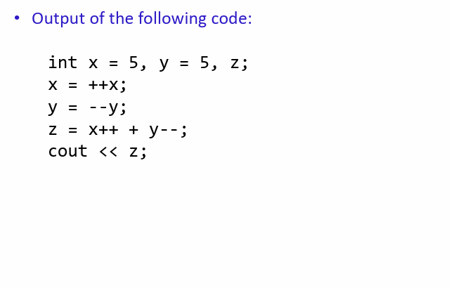

Slide 42
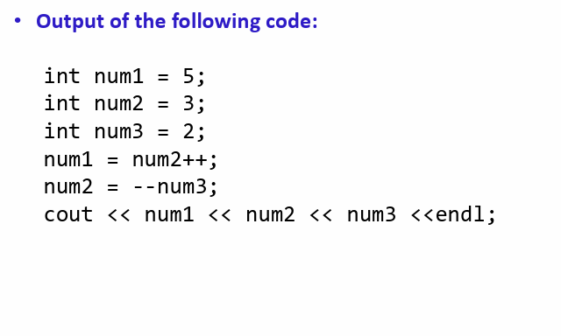

Slide 43
THANK YOU
QUESTIONS

Slide 44
Algebraic Expressions
Multiplication requires an operator
Area = lw is written as Area = l * w;
There is no exponentiation operator
Area = s² is written as Area = pow(s, 2); (note: pow requires the cmath header file) OR Area = s*s;
Parentheses may be needed to maintain order of operations
y2 − y1
m =
is written as: m = (y2-y1)/(x2-x1);
x2 − x1

Slide 45
Precedence Rules – Example 1
6 + 2 * 3 - 4 / 2
6 + 6 - 4 / 2
6 + 6 - 2
12 - 2
10

Slide 46
Precedence Rules – Example 2
3 * 4 / 2 + 3 - 1
12 / 2 + 3 - 1
6 + 3 - 1
9 - 1
8

Slide 47
Precedence Rules – Example 3
8 * 3 / 2 + 3 - 1
24 / 2 + 3 - 1
12 + 3 - 1
15 - 1
14
8 / 3 * 2 + 3 - 1
2 * 2 + 3 - 1
4 + 3 - 1
7 - 1
6

Slide 48
Precedence Rules (overriding)
For example: x = 3 * a - ++b % 3;
If we intend to have the statement evaluated differently from the way specified by the precedence rules, we need to specify it using parentheses ( )
Using parenthesis:
x = 3 * ((a - ++b)%3);

